Slide 1

Go, change the world
RV College of
Engineering
Course Code:CS344AI
IOT & Embedded Computing
Programming LPC 2148 UART[Serial Port] Programming

Slide 2

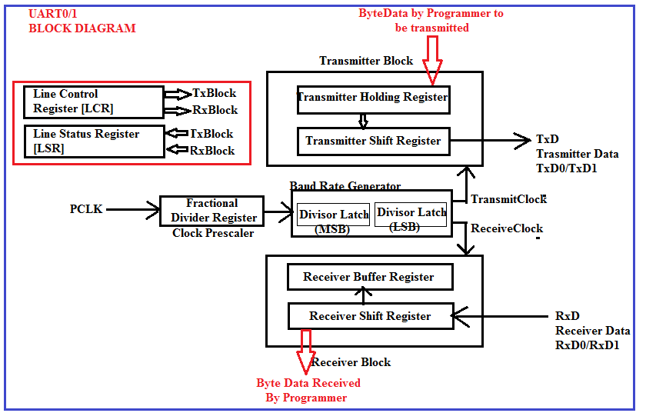
Go, change the world
RV College of
Engineering

Slide 3
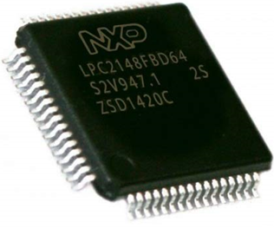
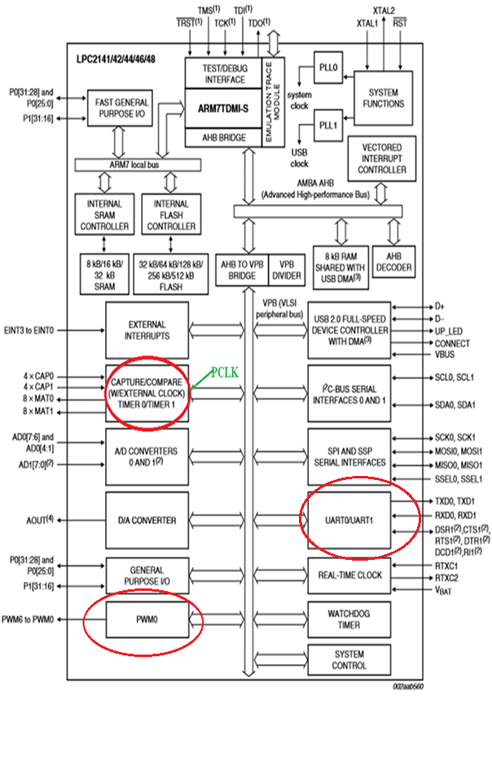
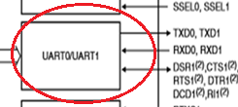
Go, change the world
RV College of
Engineering
LPC 2148 UART0 & UART1 Unit...

Slide 4
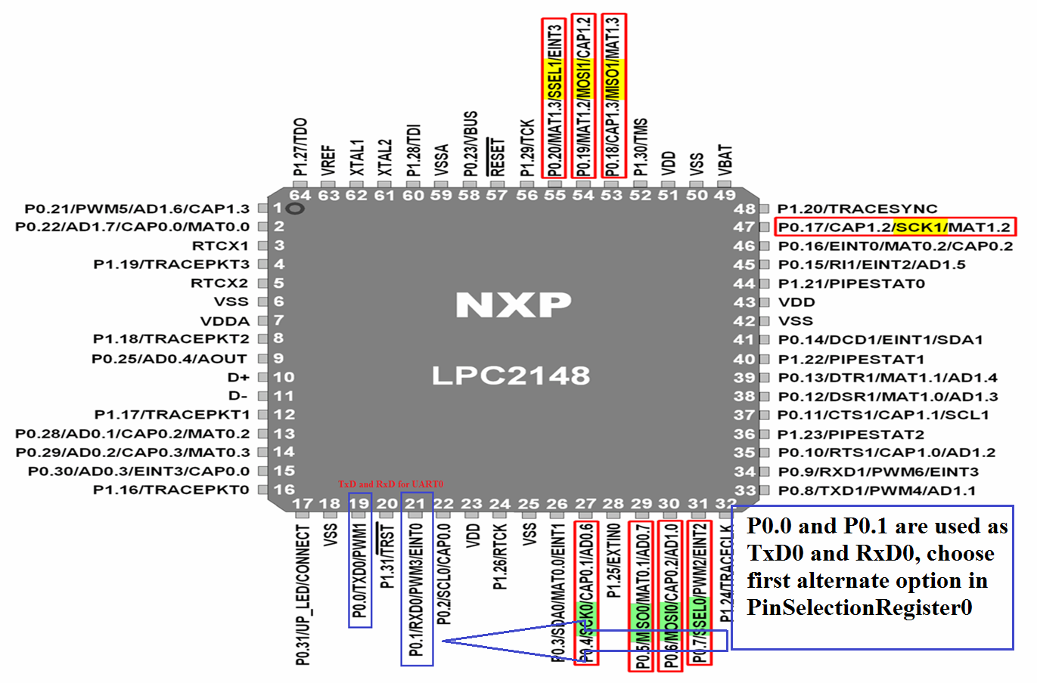
Go, change the world
RV College of
Engineering
LPC 2148 UART0 & UART1 Unit...

Slide 5
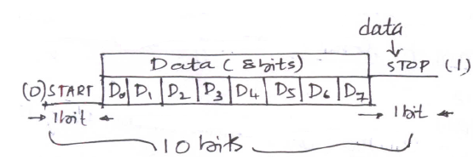

Go, change the world
RV College of
Engineering
Asynchronous Serial Data Format...

Slide 6
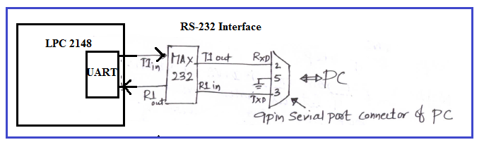
Go, change the world
RV College of
Engineering
RS 232 Interface

Slide 7
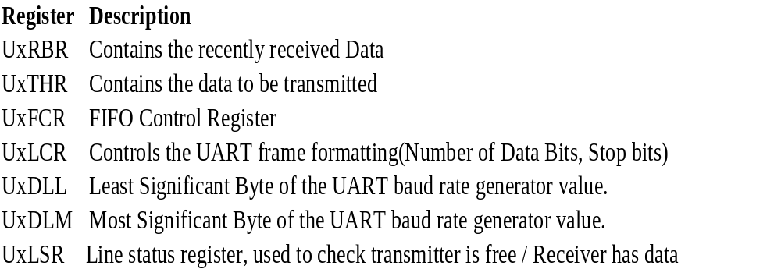
Go, change the world
RV College of
Engineering
UART Registers..

Slide 8
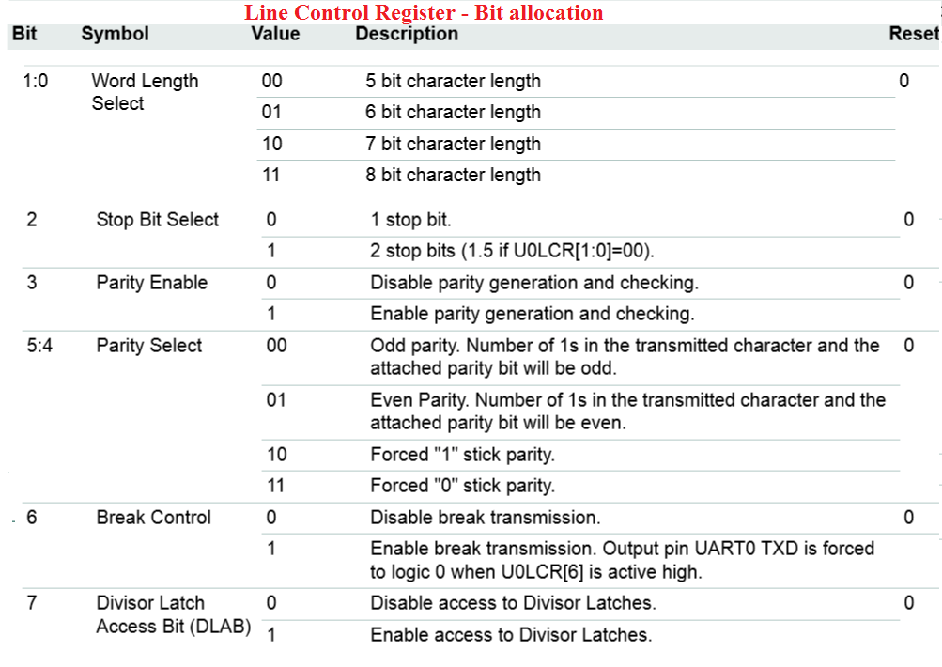
Go, change the world
RV College of
Engineering
Example: U0LCR = (0x03<<0) | (1<<7); 8bit data, 1Stop bit, No parity

Slide 9
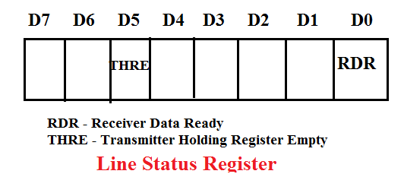
Go, change the world
RV College of
Engineering

Slide 10
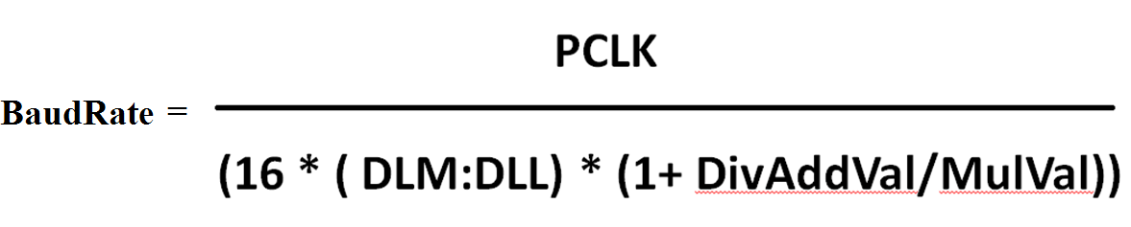
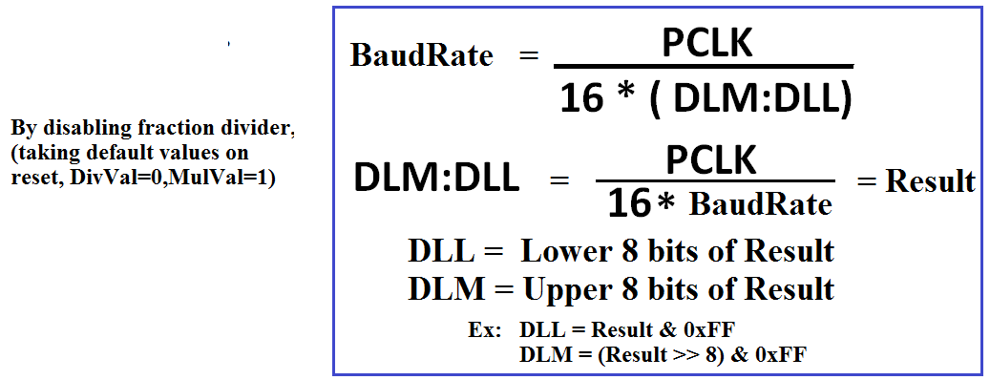
Go, change the world
RV College of
Engineering
BaudRate Calculation..

Slide 11
Go, change the world
RV College of
Engineering
Configure UART for 115200 baud rate, PCLK = 15MHz
Calculation:
DLM:DLL = 15000000 / 16 * (115200) = result
Hence, DLL = result % 256 = 8 (lower 8 bits of result)
DLM = result / 256 (upper 8 bits of result)
(or , use calculator, convert answer in decimal to HEX, take lower two digits put into DLL, next two digits to DLM)
void uart_init(void)
{
//configurations to use serial port, UART0
PINSEL0 |= 0x00000005; // P0.0 & P0.1 ARE CONFIGURED AS TXD0 & RXD0
//programming the baud rate
U0LCR = 0x83; /* 8 bits, no Parity, 1 Stop bit & DLAB = 1 */
U0DLM = 0; U0DLL = 8; // 115200 baud rate, PCLK = 15MHz
U0LCR = 0x03; /* 8 bits, no Parity, 1 Stop bit & DLAB = 0 */
}

Slide 12
Go, change the world
RV College of
Engineering
Write a Program to transmit a string from LPC 2148 to PC using Serial port / UART0
int main()
{
unsigned char i=0,ch,msg[]={"RVCE-CSE"};
SystemInit(); // set PCLK = 15MHz
uart_init(); // refer previous explanation
while((ch=msg[i++])!= '\0')
{
// Wait for Previous transmission to complete
while((U0LSR & (1u<<5))== 0x00){};
// Load the data to be transmitted
U0THR= ch;
}
}

Slide 13
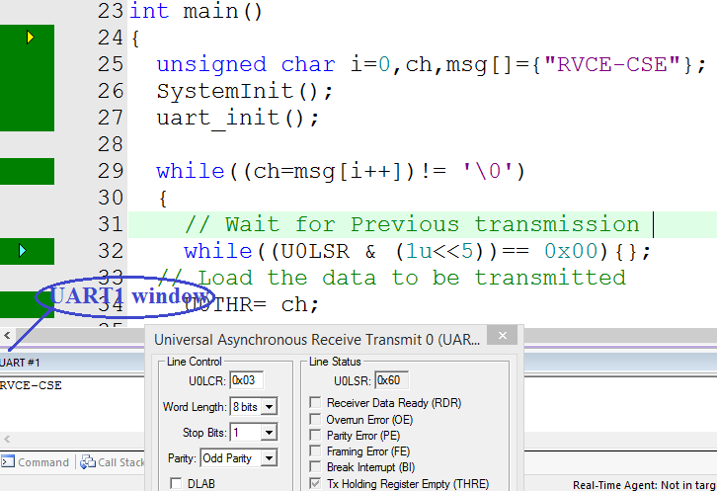
Go, change the world
RV College of
Engineering
Write a Program to transmit a string from LPC 2148 to PC using Serial port / UART0

Slide 14
Go, change the world
RV College of
Engineering
Write a Program to receive a character from PC and output the 8 bit data on P0.16 to P0.23.
int main()
{
unsigned char i=0;
SystemInit();
uart_init();
IO0DIR = 0XFF << 16; // configure P0.16 to P0.23 as output pins
do
{
while((U0LSR & (0x01<<0))== 0x00){}; // wait till, a character (8bit) is received from PC
i = UORBR; // read from the UART0
IO0CLR = 0XFF << 16;IO0SET = U0RBR << i; // output the i(8bit code) to P0.16 – P0.23
}
while(1);
}

Slide 15
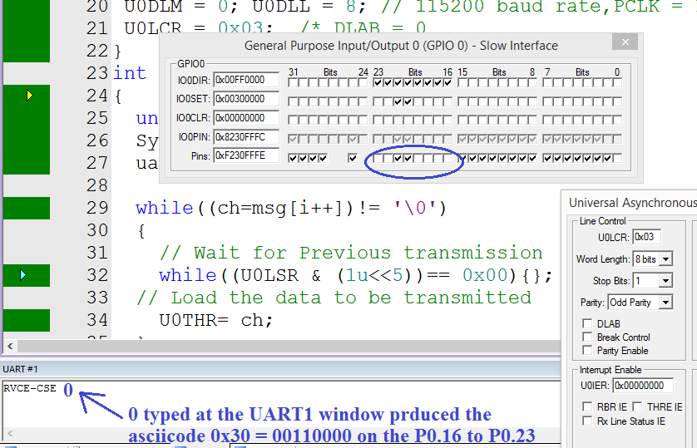
Go, change the world
RV College of
Engineering
Write a Program to receive a character from PC and output the 8 bit data on P0.16 to P0.23.

